Slide 1
Lathrop Intermediate School
How to Run MAP Reports?
Staff Meeting
Wednesday, October 14, 2015
Be Respectful
Be Responsible
Be Safe

Slide 2
Learning Objectives
Navigating MAP Reports
MAP Reports & Its Purposes
Be Respectful
Be Responsible
Be Safe

Slide 3
Teach.mapnwea.org

Slide 4
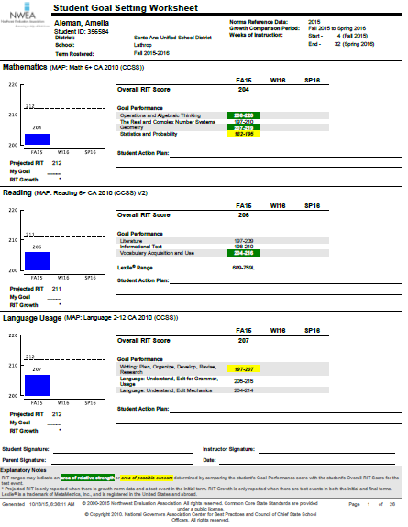
MAP Reports – Student Goal Setting Worksheet
This Report
Contains RIT Overall & Goal Performance
Math
Reading
Language
Indicates minimum projected GROWTH
States Lexile Range
Purpose?
Student knowledge in their performance and areas of improvement
Student knowledge in goal setting
Who needs this report? What would you do to guide students on this report in your role?
Students
Teachers
Counselors
Parents
Admin

Slide 5
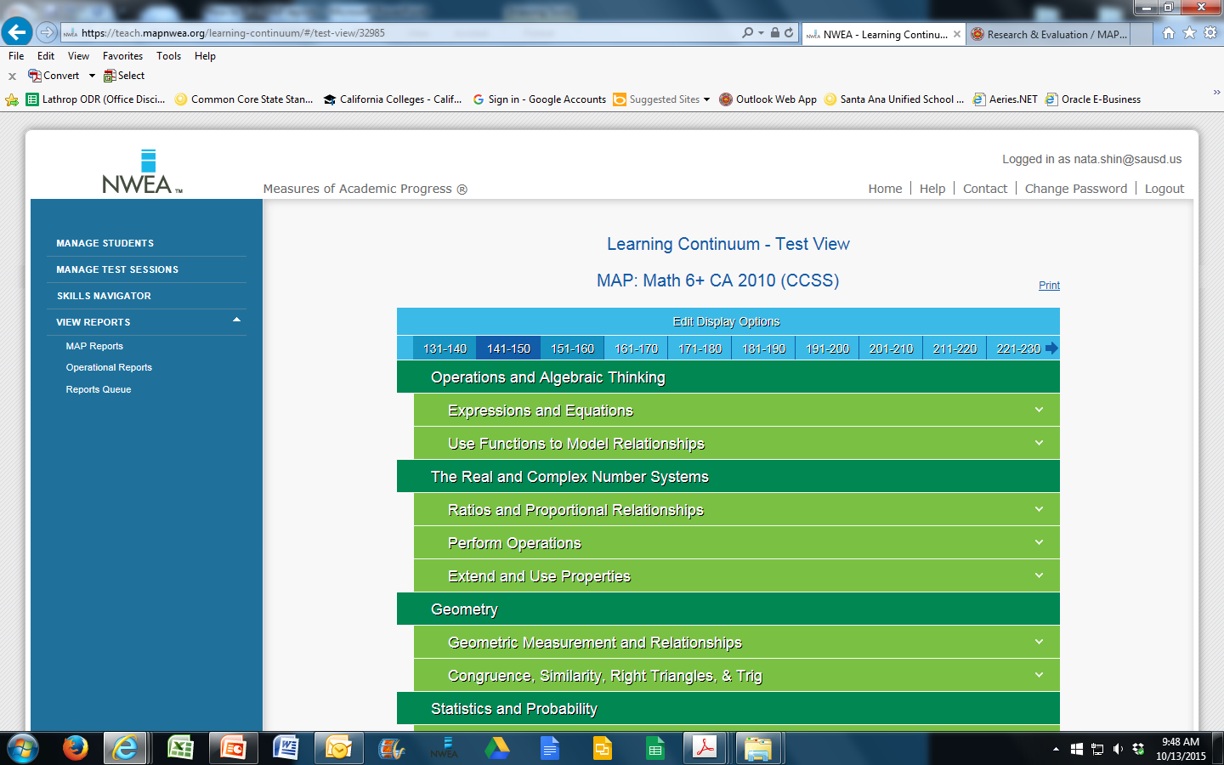
MAP Reports – Learning Continuum Test View
This report contains
A range of RIT Scores
All domains that belong to each Assessment
Different standards for each band of RIT scores on each domain
Purposes
Test view of standards being assessed for each RIT band
DOK on each RIT band
Who needs this report? How does this report help you in your role?
Students
Teachers
Counselors
Parents
Admin

Slide 6
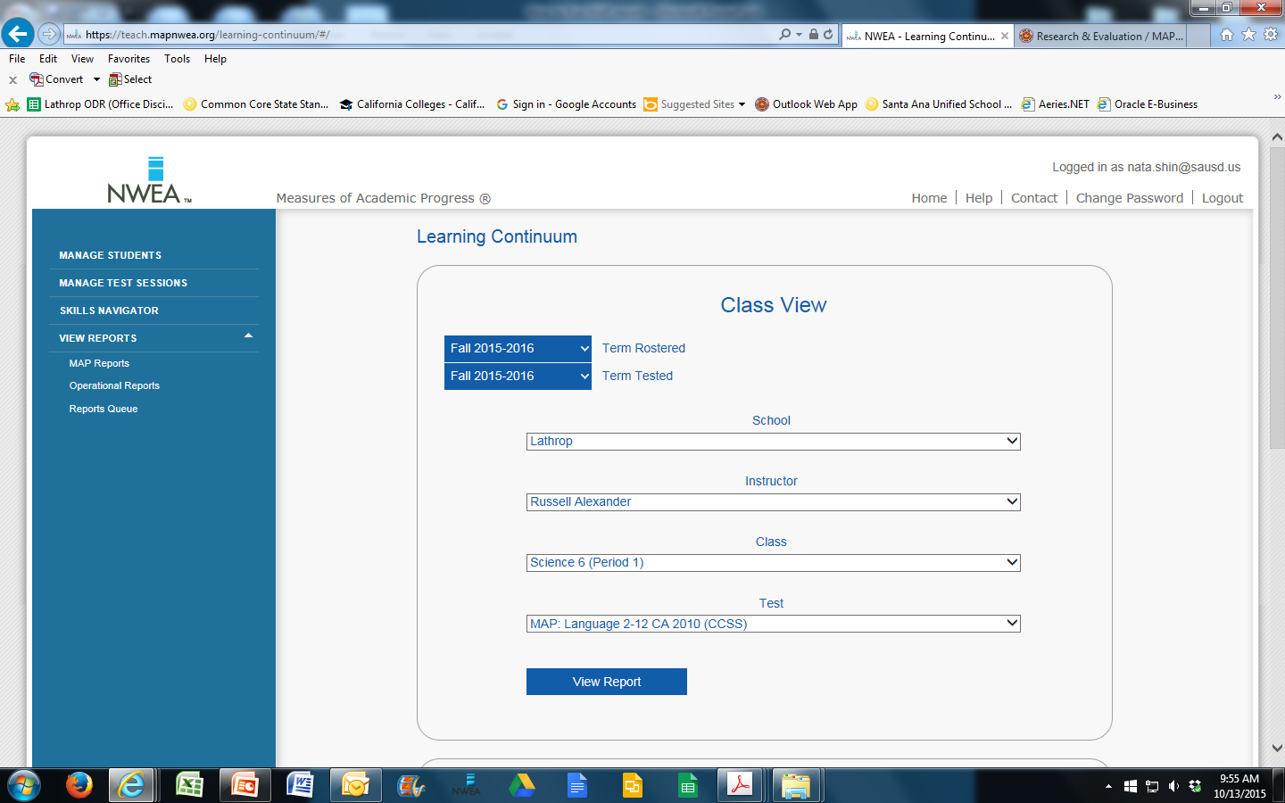
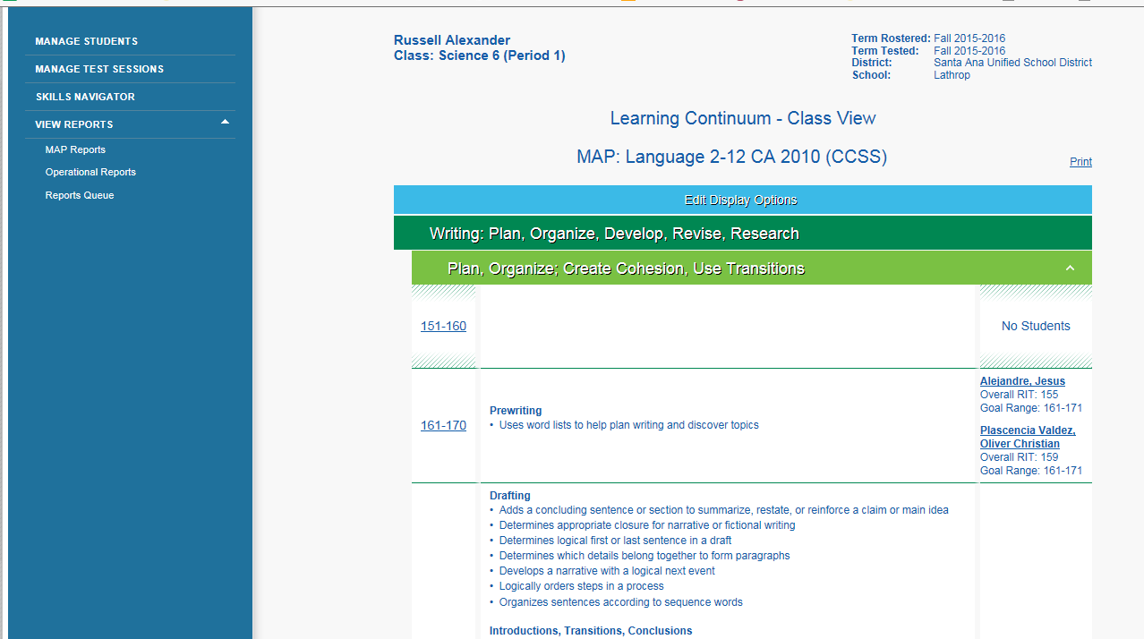
MAP Reports – Learning Continuum – Class View
How is this Learning Continuum Class View Report different from Test View?
What is the purpose for this report?
Who needs this report? And for what purpose?

Slide 7
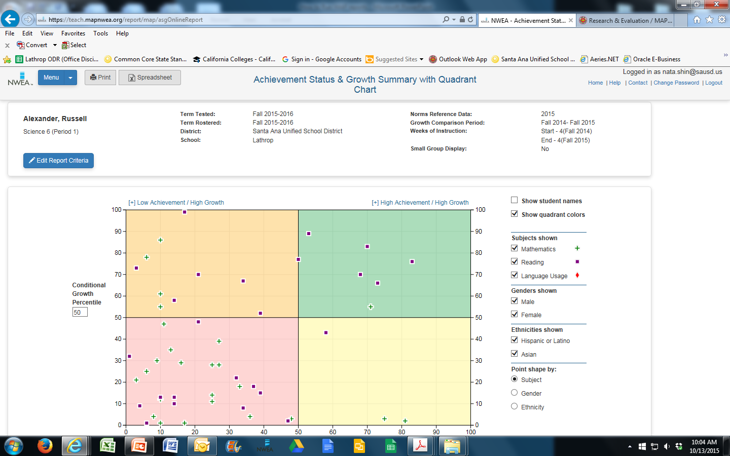
MAP Reports – Summary with Quadrant Chart
This report contains
Student’s achievement and growth
Only one class period can be displayed at a time
Student names can be shown
Purposes?
Who would benefit from this report? In what capacity?

Slide 8
MAP Reports – Summary with Quadrant Chart
How would you use this report / chart?

